Slide 1
ETS Decomposition
Renato R. Maaliw III, DIT
College of Engineering
Southern Luzon State University
Lucban, Quezon, Philippines

Slide 2
ETS
stands for Error, Trend, and Seasonality
a method used to break down a time series into three components

Slide 3
Trend (T)
Overall direction in which the time series is moving (upward, downward, stable/flat)

Slide 4
Seasonality (S)
Repeating patterns in the series (e.g. daily, monthly, yearly)

Slide 5
Residual/Error (E)
The noise or irregular fluctuations that cannot be explained by trend or seasonality

Slide 6
ETS decomposition allows us to understand the underlying patterns in a time series and helps in forecasting

Slide 7
Types of ETS Models
Additive Model
- when seasonal variations remain constant
over time

Slide 8
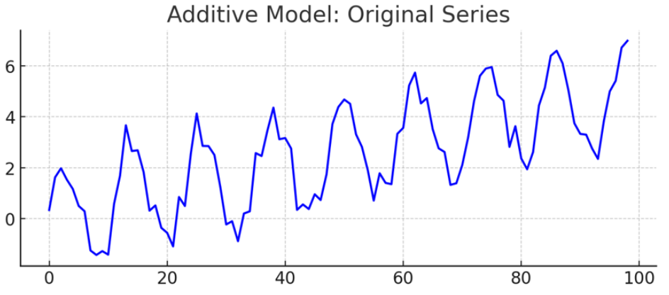

Slide 9
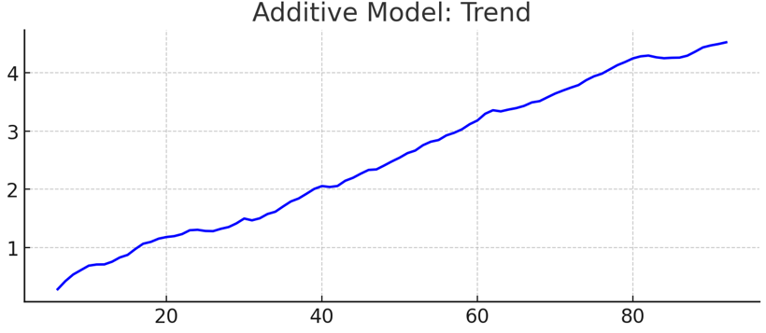
Additive Model’s trend increase linearly over time

Slide 10
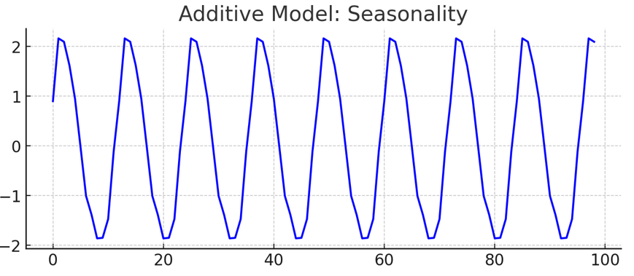
Additive Model’s seasonal pattern remains constant in magnitude
(fixed oscillations)

Slide 11
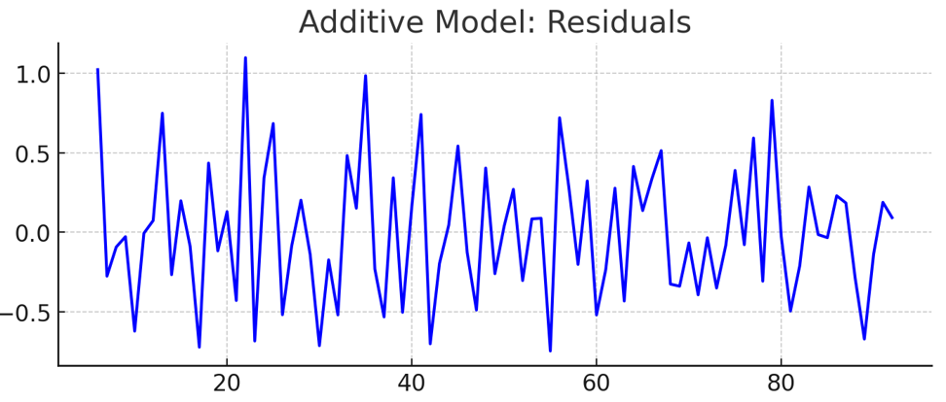
Additive Model’s residuals have constant noise over time

Slide 12
Types of ETS Models
2. Multiplicative Model
- when seasonal variations increase or
decrease in size over time

Slide 13
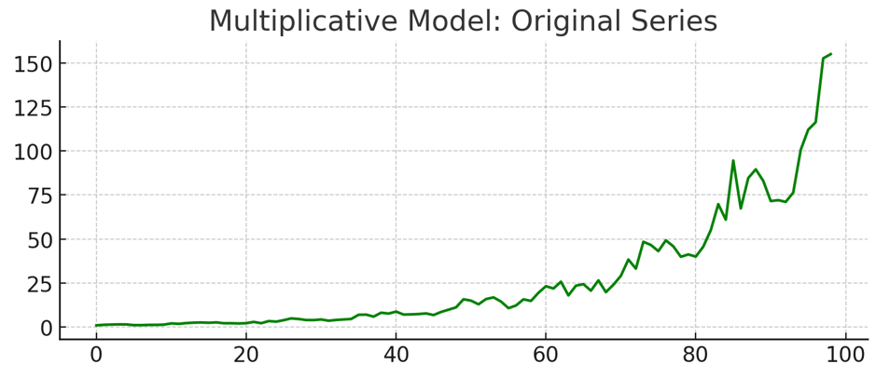

Slide 14
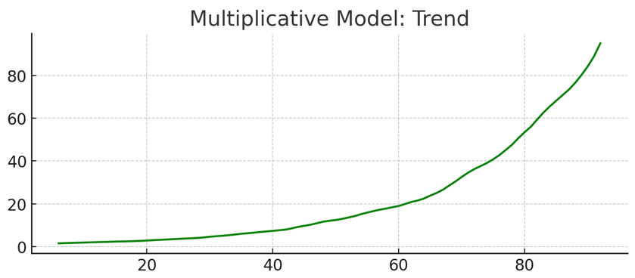
Multiplicative Model’s trend grows exponentially

Slide 15
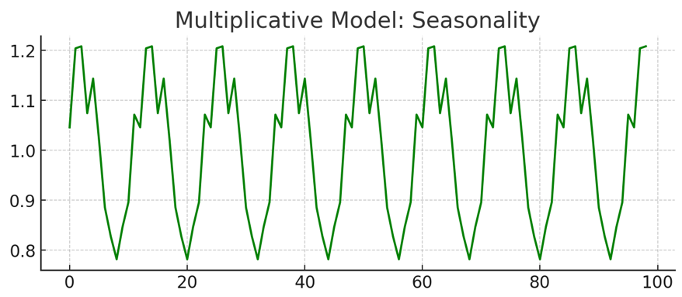
Multiplicative Model’s seasonal pattern increases in magnitude over time
(amplitude grows larger)

Slide 16
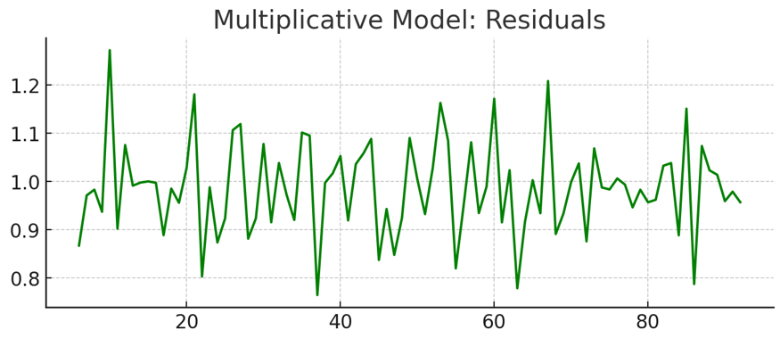
Multiplicative Model’s residuals noise grows larger as the series increases

Slide 17
[Code Demo]

Slide 18
01. What does ETS stand for in time series decomposition
A. Exponential Time Series
B. Error Trend Seasonality
C. Expert Time Series
D. Error Trial Seasonality

Slide 19
01. What does ETS stand for in time series decomposition
A. Exponential Time Series
B. Error Trend Seasonality
C. Expert Time Series
D. Error Trial Seasonality

Slide 20
02. A time series has the following except?
A. Trend
B. Inflation
C. Seasonality
D. Cycles

Slide 21
02. A time series has the following except?
A. Trend
B. Inflation
C. Seasonality
D. Cycles

Slide 22
03. How does seasonality differ from cyclical patterns?
A. Seasonality is irregular, cyclic behavior is periodic
B. Seasonality involves consistent period, cyclic behavior does not
C. Seasonality is driven by static factors, cycles are driven by changes
D. Both are identical; they can be used interchangeably

Slide 23
03. How does seasonality differ from cyclical patterns?
A. Seasonality is irregular, cyclic behavior is periodic
B. Seasonality involves consistent periods, cyclic behavior does not
C. Seasonality is driven by static factors, cycles are driven by changes
D. Both are identical; they can be used interchangeably

Slide 24
04. In an additive model, what happens to seasonal amplitude when underlying level increases?
A. It increase proportionally
B. It remains constant
C. It decreases proportionally
D. It become unpredictable

Slide 25
04. In an additive model, what happens to seasonal amplitude when underlying level increases?
A. It increase proportionally
B. It remains constant
C. It decreases proportionally
D. It become unpredictable

Slide 26
05. When would you choose a multiplicative model over an additive one?
A. Seasonal fluctuations remain constant regardless of trend
B. Seasonal fluctuations grow proportionally as trend increases
C. The series contains cyclical patterns
D. The trend is perfectly linear

Slide 27
05. When would you choose a multiplicative model over an additive one?
A. Seasonal fluctuations remain constant regardless of trend
B. Seasonal fluctuations grow proportionally as trend increases
C. The series contains cyclical patterns
D. The trend is perfectly linear

Slide 28
Thank you very much for listening.

